Slide 1
Attention Is All You Need

Slide 2
Introduction
RNNs are inherently sequential, hindering parallelization and limiting longrange dependency modeling
Introducing the Transformer architecture, a novel neural network utilizing selfattention for interelement relationship modeling
Transformers excel at capturing longrange dependencies in sequences
Transformers offer improved parallelization capabilities compared to traditional RNNs

Slide 3
Literature Review
Model performance has been enhanced, particularly in the case of the latter
Attention mechanisms have become crucial in sequence modeling and transduction models for various tasks
Transformers are a model architecture that foregoes recurrence in favor of relying solely on attention mechanisms to establish global dependencies between input and output
Attention mechanisms are typically utilized in conjunction with recurrent networks, but Transformers operate differently.

Slide 4
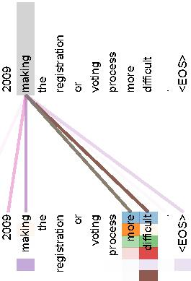
Literature Review

Slide 5
Methodology
The encoder consists of a stack of N identical layers, with the second layer being a positionwise fully connected feedforward network.
All sublayers in the model, including embedding layers, produce outputs of dimension dmodel = 512 to facilitate residual connections.
The model incorporates masking to ensure that predictions for a given position i can only depend on known outputs at positions less than i.
The overall architecture of the Transformer model is illustrated in Figure 1, with the left half representing the encoder and the right half representing the decoder.

Slide 6
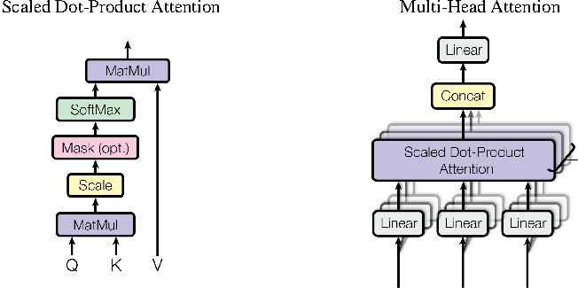
Methodology

Slide 7
Results
Model achieves 28.4 BLEU, surpassing existing best results and ensembles
Improvement over existing results
WMT 2014 EnglishtoFrench translation task:
Model achieves a new singlemodel stateoftheart score of 41.8
Achieved after training for 3.5 days on eight GPUs
Significantly lower training costs compared to best models in literature

Slide 8
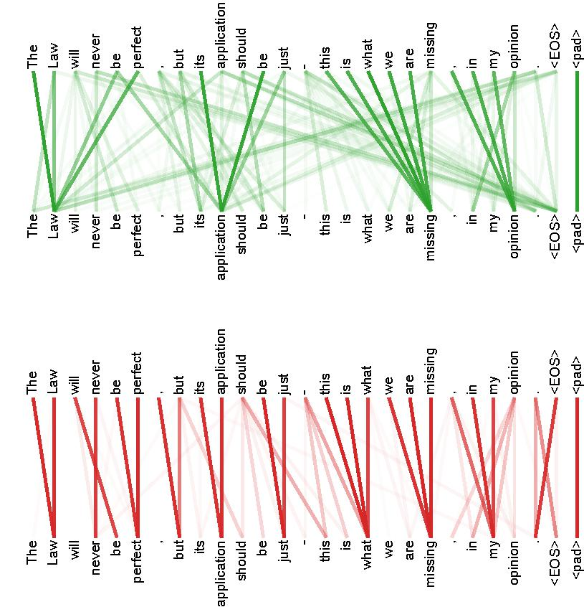
Results

Slide 9
Conclusion
Transformer relies solely on selfattention mechanisms, eliminating the need for recurrence and convolution
Superior quality demonstrated in experiments on machine translation tasks
More parallelizable and less training time required compared to existing models
Achieved 28.4 BLEU on WMT 2014 EnglishtoGerman task, outperforming existing best results by over 41.8% after training for 3.5 days on eight GPUs

